Slide 1
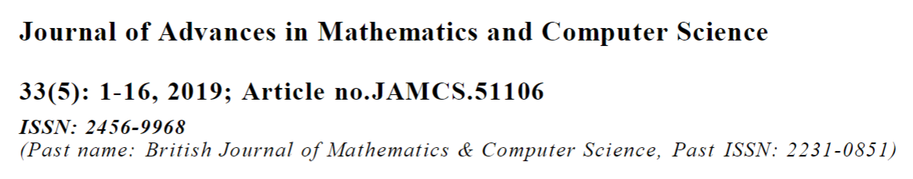
Credit Card Fraud Detection Using Autoencoder Model in Unbalanced Datasets

Slide 2
Outline
1. Introduction
2. Anomaly detection
3. Autoencoder neural network
4. Experimental Results
5. Conclusion
6. Reference
1. Introduction
2. Anomaly detection
3. Autoencoder neural network
4. Experimental Results
5. Conclusion

Slide 3
Introduction
Although it is difficult to identify them in the short term, they become clear in the long term. The electronic disclosure of financial fraud can be said to be the use of computer systems to determine whether a new licensed transaction belongs to the category of fraudulent or legitimate transactions.
Fraud Detection System (FDS) should not only be effective, but should also be costeffective.
Fraud Detection System (FDS) receives the card details and the value of purchase to verify whether the transaction is genuine or not. Bhatla [7] maintained that examining 2% of the transaction may result in reducing fraud
losses by 1% of the actual transaction value, but fraud detection costs will increase.
To minimize costs, expert rules and models based on machine learning are used to conduct the firstly examination between fraudulent and legitimate transactions and to require investigators to review high-risk cases only.
Fraud Detection System (FDS) should not only be effective, but should also be costeffective.
To minimize costs, expert rules and models based on machine learning are used to conduct the firstly examination between fraudulent and legitimate transactions and to require investigators to review high-risk cases only
With techniques machine learning (ML) we can detect fraudulent patterns efficiently and impact transactions that are likely to be fraudulent.
Transactions are first filtered by checking certain basic conditions (secure code, card number, expiration date etc.) and then recorded by a predictive model, urging that a predictive model can be formed based on expert rules only.
These rules require manual control and human supervision. With techniques machine learning (ML) we can detect fraudulent patterns efficiently and impact transactions that are likely to be fraudulent.
The machine learning (ML) techniques are the conclusion of a prediction model based on a set of predefined examples. In most cases, this model is a parametric function which allows predicting the probability that the transaction will be fraudulent.

Slide 4
Introduction
Fraudulent credit card transaction is still one of problems that face the companies and banks sectors; it
causes them to lose billions of dollars every year. The design of efficient algorithm is one of the most
important challenges in this area.
This paper aims to propose an efficient approach that automatic detects fraud credit card related to insurance companies using deep learning algorithm called Autoencoders.
The effectiveness of the proposed method has been proved in identifying fraud in actual data from transactions made by credit cards in September 2013 by European cardholders.
In addition, a solution for data unbalancing is provided in this paper, which affects most current algorithms.
The suggested solution relies on training for the autoencoder for the reconstruction normal data.
Anomalies are detected by defining a reconstruction error threshold and considering the cases with a superior threshold as anomalies.
The algorithm's performance was able to detected fraudulent transactions between 64% at the threshold =
5, 79% at the threshold = 3 and 91% at threshold= 0.7, it is better in performance compare with logistic
regression 57% in unbalanced dataset.
Adopt a new model for detecting Fraudulent credit card transaction using deep Learning Algorithm called Autoencoders
The propose model can achieve higher performance than the other state-of-the-art one-class methods according to Recall.
The main contributions of this work are as follows:
- Briefly introduce previous algorithms, used to detect fraudulent credit card transactions depends in machine learning.
- Adopt a new model for detecting Fraudulent credit card transaction using deep Learning Algorithm called Autoencoders
- The propose model can achieve higher performance than the other state-of-the-art one-class methods according to Recall.

Slide 5
Introduction
Fraudulent credit card transaction is still one of problems that face the companies and banks sectors; it
causes them to lose billions of dollars every year. The design of efficient algorithm is one of the most
important challenges in this area.
This paper aims to propose an efficient approach that automatic detects fraud credit card related to insurance companies using deep learning algorithm called Autoencoders.
The effectiveness of the proposed method has been proved in identifying fraud in actual data from transactions made by credit cards in September 2013 by European cardholders.
In addition, a solution for data unbalancing is provided in this paper, which affects most current algorithms.
The suggested solution relies on training for the autoencoder for the reconstruction normal data.
Anomalies are detected by defining a reconstruction error threshold and considering the cases with a superior threshold as anomalies.
The algorithm's performance was able to detected fraudulent transactions between 64% at the threshold =
5, 79% at the threshold = 3 and 91% at threshold= 0.7, it is better in performance compare with logistic
regression 57% in unbalanced dataset.
The solution relies on training for the autoencoder for the reconstruction normal data.
Anomalies are detected by defining a reconstruction error threshold and considering the cases with a superior threshold as anomalies.

Slide 6
2 Literature Review
Neural networks [8-10] and logistic regression [11,12] are often chosen for their well-established popularity,giving them the ability to be used as a control method by which other techniques are tested. Comparatively,more advanced methods such as support vector machines and genetic programming have receivedsubstantially less attention [6].
Most studies have focused on the use of machine learning methods for supervised learning and unsupervised. However, recent studies indicate a trend towards using hybrid methods of the former two types to combine their advantages.
This section discusses a number of methods used in fraud detection, the most important traditional methods such as algorithms for optimization and machine learning. This section will focus on machine learning methods, as they are considered the most widely used methods so far.
2.1.1 Supervised learning methods
Some techniques of machine learning treat transaction fraud as a problem of supervised classification. In this manner, together with annotations, we can train a classifier based on training data, then classify test transaction data into normal and abnormal classifications.
A systematic review of 49 papers in the same field showed that decision trees, neural networks, logistic regression and SVM were the preferred methods among many other methods [13].
Bhattacharyya [11] compared between the accuracy of logistic regression and random forest and SVM on real data, which contain varying percentage of fraud in training groups, random forest showed high precision versus low rates of recall.
Some studies have dealt with the problem of unbalanced data, which is one of the most important problems facing algorithms lassification, using several methods: Over-sampling, Under-Sampling and Synthetic Minority Over-sampling Technique.
2.1 Machine learning methods
The machine learning methods are divided into groups: supervised learning methods and unsupervised learning methods. In this paper, the researcher attempts to examine the use of machine learning methods in the classification between fraudulent transactions and legitimate transactions. However, classification is located algorithms within the field of machine learning supervision, so the study will focus only on research that fall within this area.
Over-sampling refers to the process of increasing the number of records in the minority class, but increasing the number of records leads to minority class bias and increase the size of the training set and also, increase training time and the amount of memory required to hold the training set, it is not efficient In the case of big data.
Under-Sampling refers to the process of decreasing the number of records in the majority class.

Slide 7
As a result, the overall number of records in the training set is greatly reduced. This means that during classification, training time is also greatly reduced. It is possible that we will lose a lot of valuable information if we eliminate documents that could be useful to our classifier in building an accurate model [14].
Synthetic Minority Oversampling, oversamples the minority class by generating synthetic examples in the neighborhood of observed ones. The idea is to form new minority examples by interpolating between samples of the same class [14].
Studies have proven that the combination of these two technologies has great effectiveness in achieving the balance of data. Successfully applied these techniques to the problem of detecting fraud in the credit card, however, Fraud detection algorithms need to know that the conditional balance of a class may change over time [15].
The methods of detecting anomalies take a different perspective, the model is constructed for legitimate instances and the transaction is then evaluated as anomalies not in accordance with this model. These methods require that the Score be determined for anomalies that determine the extent to which a situation is abnormal [16].
Feature engineering for temporal sequences
Choosing features when creating fraud credit card is critical to accurate classification. It is not surprising that great research efforts are devoted to the development of expressive features. However, as noted in [17] a single transaction information is not sufficient to detect a fraudulent transaction, since using only the raw features leaves behind important information such as the consumer spending behavior, which is usually used by commercial fraud detection systems.
Detect traditional fraud system features as inputs for the training of binary systems works adopted as it deals with the treatment level of total disregard of the fact that the frequency and size of transactions at certain time intervals can carry valuable information for each individual account.
Credit card data is represented as a graph. The node is the cardholder or the merchant while the edges are transactions between the nodes. The weight of the edges is determined by the size of transactions
between these entities and decreases over time.
The graph extracts network features that measure the extent to which each entity is exposed to a fraud. These features include a score for the cardholder, the merchant and the transaction grouped at short, medium and long intervals [18].
Fraud Credit card is not restricted to transactions only, but to transactions and the features in which they occur. In recent years, interest in features has been observed by studying several factors such as the date of purchase, the record of the customer activity, that enable the classifier to better identify fraudulent transactions. So this paper will review two strategies of study literature that allow context description.

Slide 8
Sequential learning is the study of learning algorithms for sequential data. These methods include sliding window methods, recurrent sliding windows or conditional random fields. While sliding window based approaches tend to ignore the sequential relationship between data points inside the windows, a better solution is to resort to model-based approaches that assume explicitly a sequential dependency between consecutive data points. In its simplest form such model could be a Markov chain defined on the data points
[19].
However, the sequential dependence is presumably more evident or useful in many practical applications as a sequence of latent, so-called hidden, states that control the sequence of observed data points[19].
Recurrent neural network is represents a hidden identity of the family of non-probability models. The Recurrent neural network is trained to periodically identify fraudulent transactions given the sequence of transactions in the past.
Long Short-Term Memory network (LSTM) has recently raised a lot of attention because of its ability to learn long-term dependency.
It constitutes the state of the art on many real world
tasks such as speech recognition, hand writing recognition and statistical machine translation [19].
Fraud detection ways recently started the trend towards the use of a hybrid approach by integrating more than algorithm to take advantage of the features of each, such us: Latent Dirichlet Allocation(LDA) ,to analyze text data within a set of documents that represent traffic accident reports and extract text features using natural language processing techniques, such as (the color of the car - the type of car - the description of the incident) and then used the advantages extracted to train the deep neural network to detect fraud within a
range of textual claims submitted to insurance companies. The accuracy of neural networks in classifying claims has increased significantly as a result of the use of natural languages [20].
Neural networks were integrated with genetic algorithm to detect credit card fraud. A neural network of back propagation and its components was used from several layers and the genetic algorithm was introduced to decide the structure of the network, the network topology, the number of hidden layers and the number of nodes in each layer [21].
Used algorithms decision trees and Supper Vector Machines (SVM), respectively, to build a classification model for fraud detection within the real data of credit cards class, results showed that decision tree approaches outperform SVM approaches in solving the problem [22,23].

Slide 9
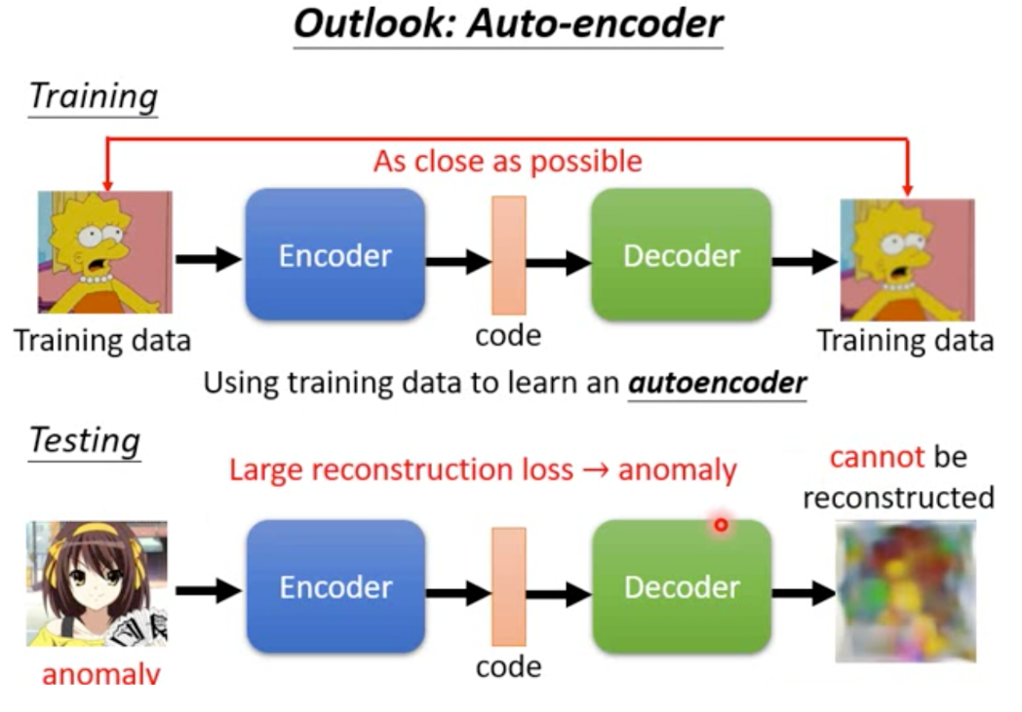
Autoencoder(1/3)
把所有訓練資料 Encode
輸入一張圖片先 encode 成一個向量 code 再依據 code 過 decode 回原來的圖片
訓練過程：讓 Decoder 後的圖片，跟 input 端的圖片越像越好！
機制：如果是正常的測試資料輸入，圖片可以還原回來，還原度較高。異常資料輸入時， Decoder 還原出來得圖片就會根原圖差異蠻大的，可作為偵測異常用
http://violin-tao.blogspot.com/2019/03/ml-anomaly-detection-machine-learning.html

Slide 10
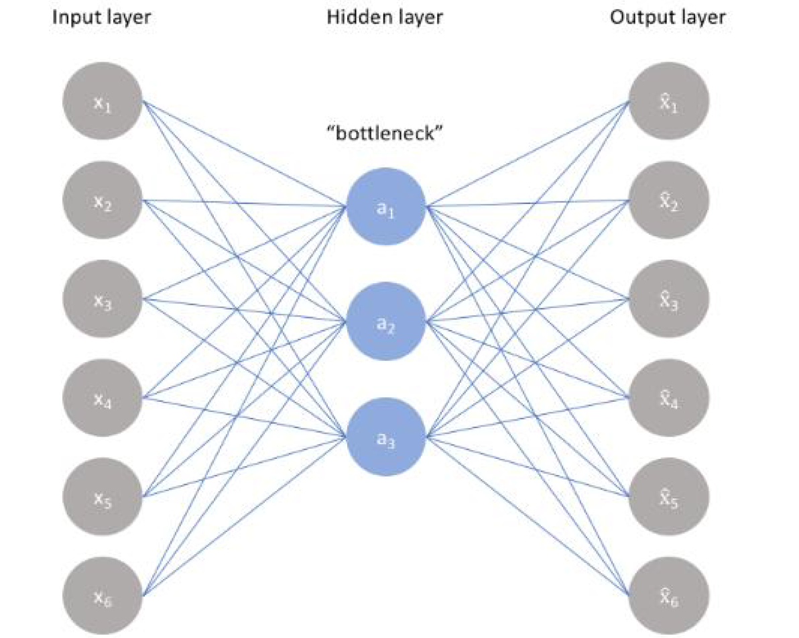
Autoencoders
3.1 Architecture neural network
The network architecture for autoencoders can vary between a simple Feedforward network, LSTM networkor Convolutional Neural Network depending on the use case. In this case the Feedforward network will beused.
Autoencoders architecture consists of four main parts:
- Encoder: it is the part in which the model learns how to reduce the input dimensions and compress
the input data into an encoded representation.
- Bottleneck: it is the layer that contains the compressed representation of the input data. This is the
lowest possible dimensions of the input data.
- Decoder: it is the model that learns how to reconstruct the data from the encoded representation to be
as close to the original input as possible.
- Reconstruction Loss: this is the method that measures measure how well the decoder is performing
and how close the output is to the original input.
3 Autoencoder Classifier
Autoencoder learn is a unsupervised learning seeking to be output corresponding to their income and therefore can be considered the network as a supervised learning , the output (x head) is the result of reconstruction the original income x.
An autoencoder learns to map from input to output through a pair of encoding and decoding phases. The encoder maps from the input to hidden layer, the decoder maps from the hidden layers to the output layer to reconstruct the inputs. Hidden layers of the autoencoder are low dimensional and nonlinear representation of the input data [24].
Autoencoders architecture consists of four main parts
Encoder (number of nodes in middle layer )
Bottleneck
Decoder
Reconstruction Loss
There is a bottleneck issue in the autoencoder. A bottleneck constrains the amount of information that can traverse the full network, forcing a learned compression of the input data [25]. Fig. 1 shows the autoencoder with the hidden layer.
瓶頸限制了可以遍歷整個網絡的信息量，從而迫使學習的輸入數據壓縮[25]

Slide 11
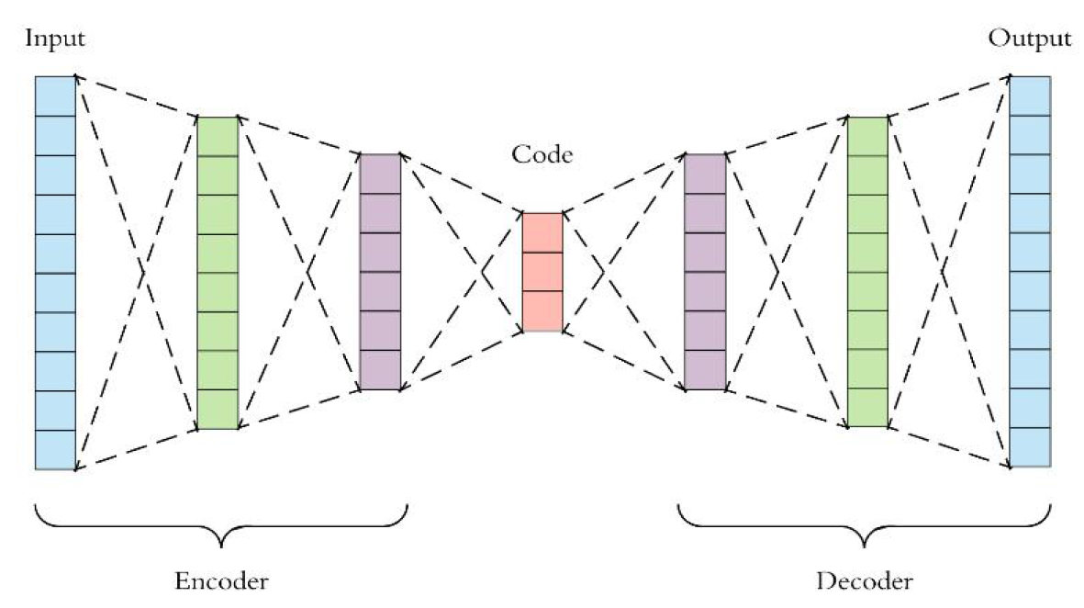

Autoencoders
four hyper parameters
Code size (number of nodes in middle layer )
Number of layers
Number of nodes per layer
Loss Function (Mean square error )
The training then involves using back propagation in order to minimize the network’s reconstruction loss.
There are four hyperparameters that are required before setting out training an autoencoder:
1. Code size: when the number of nodes in middle layer is small then the great pressure.
2. Number of layers: flexible number of layers (depth of layers).
3. Number of nodes per layer: the number of nodes in each layer decreases after the encoder, and is increased again in the decoder, and the number of nodes can be selected in each layer according to need.
4. Loss Function : the error resulting from the reconstruction of the input data in the output layer, and the Mean square error is used to calculate the error value, such as equation 1 below:

Slide 12
Experimental Results
• Confusion Matrix
The confusion matrix is used to describe the performance of the proposed classification model for selecting a data set and is the form of 4 different sets of expected real values, where the confusion matrix provides the number of transactions per set. In the following Table 2 and Table 3 [28] we provide an overview of performance measures based on the confusion matrix:
4 Experimental Results
4.1 Dataset
The Machine Learning Group of ULB (Université Libre de Bruxelles) and Worldline cooperated to collect the dataset for big data mining and fraud detection. This dataset contains two days’ transactions of credit cards in European which is composed of 284,315 normal transactions and 492 fraudulent transactions. The dataset is highly unbalanced, the positive class (frauds) account for 0.172% of all transactions [26]. The dataset does not need any data cleaning process; it does not contain duplicate entries, Huge Outliers, and Null values.
Table 2 and Table 3 show the performance measures for evaluating the performance of the autoencoder model, three indicators are used (precision, recall and f1 score). Precision (also called positive predictive value) is the fraction of true frauds among all samples which are classified as frauds, while recall (also known as sensitivity) is the fraction of frauds which have been classified correctly over the total amount of frauds. TP (True Positive) refers to the amount of fraud properly classified. FP (False Positive) refers to the amount of normal transactions classified as fraud. FN (False Negative) refers to the amount of fraud classified as normal. TN (True Negative) refers to the amount of normal transactions correctly classified.
However, these measures may not be the most appropriate evaluation criteria when evaluating fraud detection models, because they tacitly assume that misclassification errors carry the same cost, similarly with the correct classified transactions.
Two day’s transactions of credit cards Number of layers
284,315 normal / 492 fraudulent transactions
Highly unbalanced (0.172%)
Mean squared error is used to calculate the value of the reconstruction error
The high error value indicates the discovery of fraudulent transactions while the low value reveals legitimate transactions
4.2 Research method
Was developed algorithm depend on neural networks type autoencoder and evaluate their performance and ensure its ability to detect fraud cases as appropriate. Several measures were used:
• Reconstruction error
The Mean squared error is used to calculate the value of the reconstruction error:
The high error value indicates the discovery of fraudulent transactions while the low value reveals legitimate transactions.
• Precision & Recall
Precision and Recall are one of the most widely used standards in unbalanced data, which reflects the precision of the suitability of the result scale and proximity to the expected solution, while recall measure of the number of relevant results returned, the goal in each of them to approach the one. High score recall indicates a low False Negative (FN) rate, while high precision indicates a low False Positive (FP) rate. High Scores for both show that the classifier restores accurate results in addition to the recovery of the majority of the positive results [27].

Slide 13
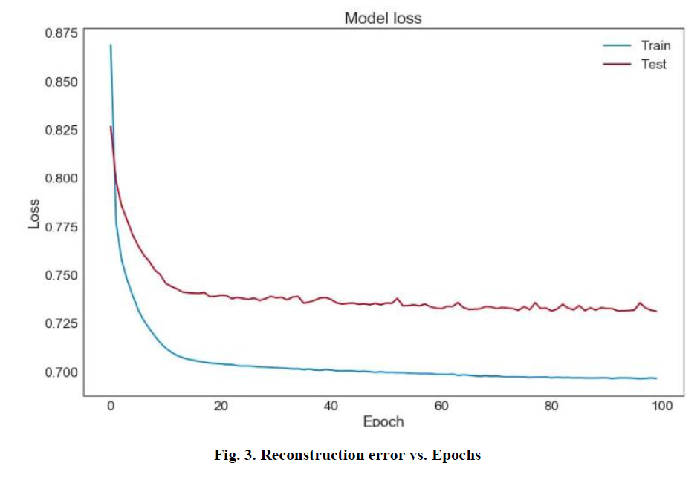
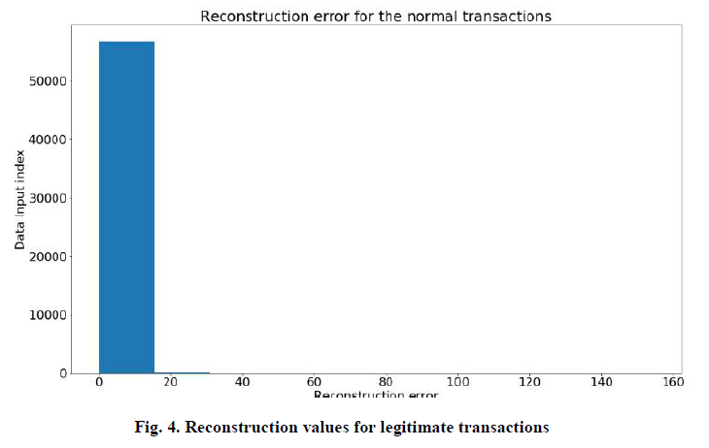
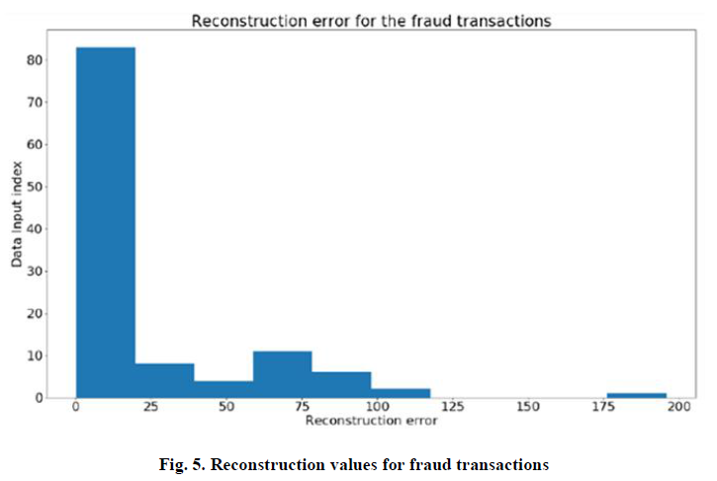
The decrease in the value of loss from reconstruction as the number of repeat increases
5 Results and Discussion
5.1 Build the proposal model
The application was built using the Python language based on a set of software libraries and the most important:
▪ Karas: Library provides simple and consistent software interfaces for communication with the end user, not the machine, and contains a set of models such as neural networks, decision trees and activation subsystems,as well as their scalability. The main task of the library is to make the application more responsive and give the user more power on the interface control.
▪ Tensor Flow: Library is applied in many fields such as derivatives and large matrices as well as in the distribution of computer operations on central processing units(CPU) as well as on a distributed network
consisting of a collection of remote devices including this library. Mainly used in machine learning at present.
▪ Apply autoencoder algorithm
The algorithm used for autoencoder has been applied in several stages:
Network training stops when it becomes reconstruction error as less possible. The network input is approximately equal to the output. So after experimenting number of epochs, in epoch No. 51, we note that
the reconstruction error to less as possible, and that the network reached enough to reduce redundancy. The following figure illustrates the decrease in the value of loss from reconstruction as the number of repeat increases.
隨著重複次數的增加，重建損失值的降低
Experimental Results
5.2 Evaluate algorithm performance
• Reconstruction Error
In the measuring of Reconstruction Error, Figs. 4 and 5 illustrate the value of the reconstruction error for both legitimate and fraudulent transactions, where the value of the error for legitimate transactions is very small, while its value is significant in the case of fraudulent transactions.
1. The data were divided into 80% training data and 20% testing data based on the experiment. The training data contains only legitimate transactions, so that the network can form a compressed representation and distinguish it from fraudulent transactions.
2. Selecting the number and size of layers experimentally comes next. The following network was chosen experimentally from Left to Right 32-14-7-7-32 five Layers. The first layer represents the network input, while the second and third layers encode the data. In the fourth and fifth layer the data is reconstructed, and the Loss Function is calculated. the most important that the input layer is equal to the output layer in terms of the number of neurons.

Slide 14
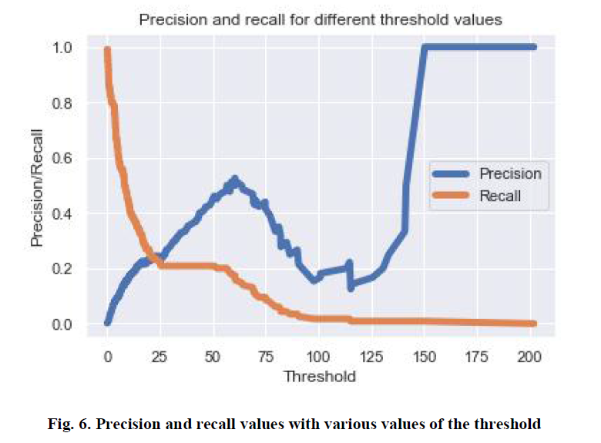
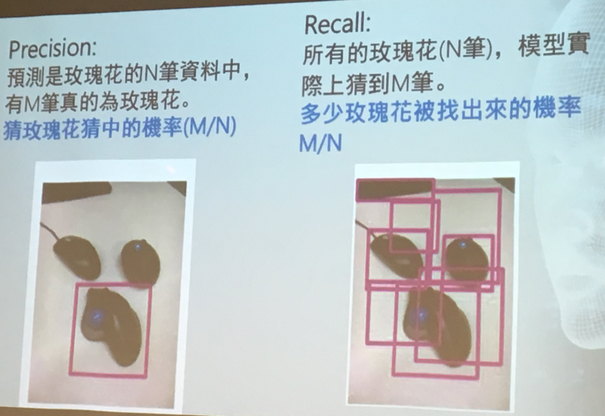
The higher the value of the threshold is, the higher the precision is, while the value of the recall decreases.
• Precision & Recall
In the measuring of Precision and Recall, The following Fig. 6 shows the precision and recall values for different threshold values that represent the error of reconstruction and are used as a boundary between legitimate and fraudulent transactions within the credit card fraud detection model using the Autoencoder network.
Experimental Results
Fig. 6, it shows that the higher the value of the threshold is, the higher the precision is, while the value of the recall decreases. For example, for the threshold value = 50, the precision value is = 0.4 while the value of the recall is = 0.2.
Based on the differential shown in Fig. 6, the value of threshold 5 is chosen for the proposed model, and thus the data set is divided into two sub-groups.
The first group contains a large majority of the data and the error of reconstruction is very small. Therefore, all transactions are considered legitimate.
The second group contains a small percentage of the data with large values of the reconstruction error, and all transactions are considered fraudulent.

Slide 15
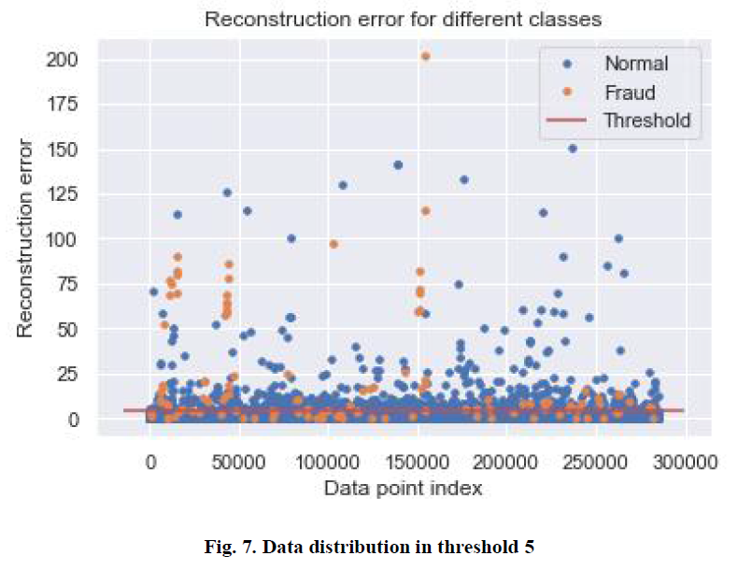
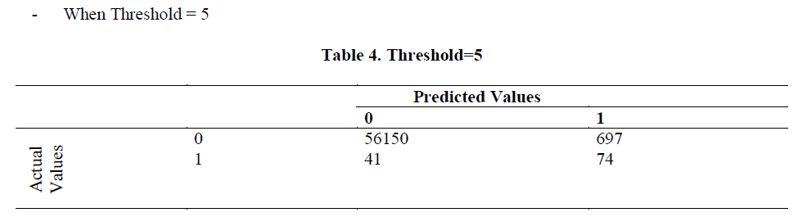
The high error value indicates the discovery of fraudulent transactions while the low value reveals legitimate transactions
Consequently, all data point above the threshold represent fraudulent transactions, since this model must contain a low reconstruct error in legitimate transactions. The following Fig. 7 illustrates the classification of transactions using the threshold value = 5.
Fig. 7 shows that most fraudulent transactions are properly classified with relatively few legitimate transactions classified as fraudulent confusion matrix confirms that. Different threshold values can be selected based on the situation that appears. For example, if the problem of many false alarms can be ignored in exchange for more fraudulent transactions, then a low threshold value 3 may be chosen. However, the proportion of legitimate transactions would be classified as fraudulent. Fig. 8 confirms this through the confusion matrix.
高於閾值的點都代表欺詐交易
Experimental Results

Slide 16
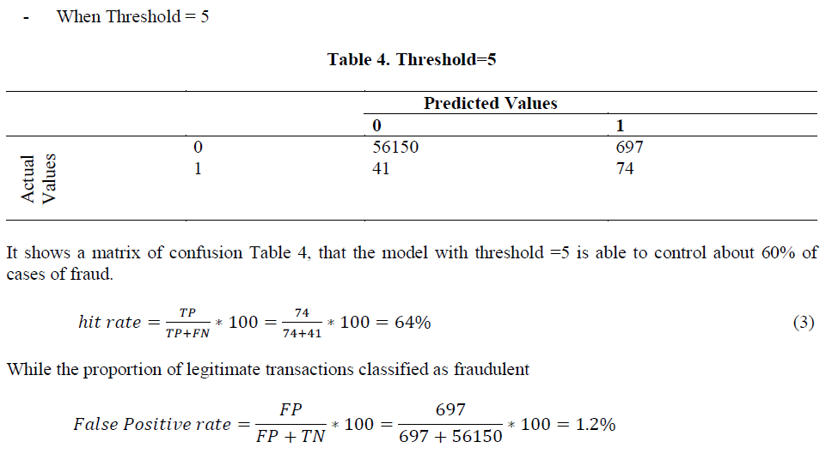
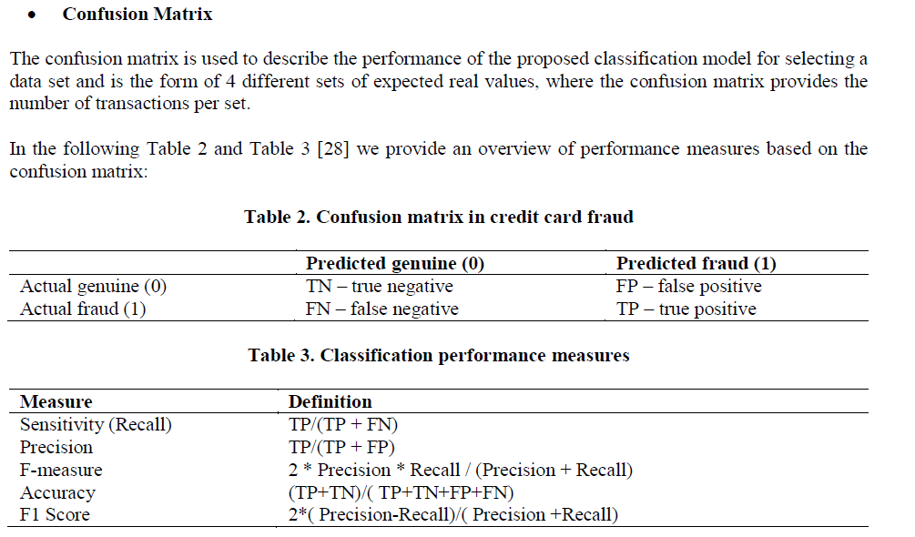
Confusion matrix is used to describe the performance of the classification model
Experimental Results

Slide 17
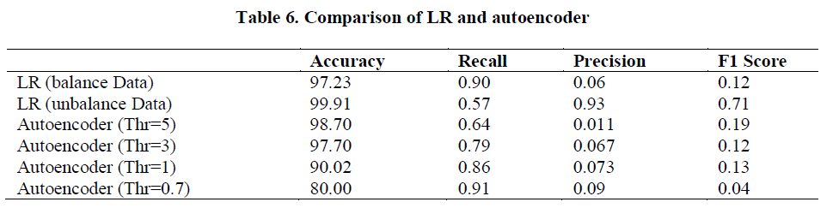
Table 6 shows the superiority of the logistic regression in the case of balanced data on the state of the unbalanced data.
Where the number of fraudulent transactions discovered is more important than the precision of the model if the fraud is discovered to reach its value in the case of balance of data 90% according to the value of the recall.
There is also a slight superiority of the utoencoder network at the threshold of 0.7 on the logistic regression where the percentage of fraudulent transactions detected is 91%, on the other hand, the model suffers from more false notification. The Table 6 also, shows the convergence of both algorithms at threshold 3.
In the autoencoder network. The value of the threshold can be changed and reduced to show a high accuracy result in the fraudulent transaction detection, but the classifying legal transactions as fraudulent will increase.
For example, detect many fraudulent transactions? or reduce false
warnings? And so on during the variation between the values of recall and accuracy, for example, note that the value of the accuracy exceeds the value of the recall at threshold 5, in contrast to the threshold at 0.7.
The previous variation is not possible if the logistic regression is used to build a fraud detection model. Autoencoder network does not need to use the data balance methods to achieve the model unlike logistic regression that needs to balance data before the construction of the model.
The confusion matrix shows that it has a significant role in etermining what is required of the model. The lower values of the threshold reflect more fraudulent cases, but more false classifications of legitimate transactions as fraudulent.
By choosing a high value threshold, there is a significant reduction in false notification for legitimate transactions and the discovery of fewer frauds. The discernment process is often subject to the decision of companies and financial institutions.
Experimental Results
Autoencoder network does not need to use the data balance methods
Autoencoder can achieve higher performance than logistic regression according to Recall.
6 Results Comparison
The performance of the algorithm must be more closely compared with other algorithms used to classify data between fraudulent and non-fraudulent.
Comparison with logistic regression has been made, because of its uses in classification.
The following Table 6 compares the Logistic Regression(LR) algorithm in the case of balanced data and unbalanced data with the Autoencoder network at several threshold values( Thr=5, 3,1 and 0.7).

Slide 18
Conclusion
7 Conclusions and Recommendations
With the large and ongoing financial loss currently being experienced by financial companies, It was necessary to develop more efficient methods on which the electronic systems to detect fraudulent
transactions, fraud detection is a very difficult and complex task. Fraudulent activities are rare events that are difficult to model, and the large volume of day-to-day transactions requires automated tools to support the science of fraud verification.
In this paper, some advanced techniques have been introduced to detect the fraud credit card of the insurance company. This study reviewed how machine learning can be used to address some of the issues of financial fraud detection in credit cards. The focus, on the design model is capable of reporting the most fraud transactions for investigators using autoencoder algorithm way that can deal with unbalanced datasets. The algorithm was able to detect between 64% at the threshold = 5 , 79% at the threshold = 3 and 91% at
threshold= 0.7.
Autoencoder can deal with unbalanced datasets
The solution relies on training for the autoencoder for the reconstruction normal data.
Anomalies are detected by defining a reconstruction error threshold and considering the cases with a superior threshold as anomalies.
The algorithm also provided a solution to avoid the problem of data balancing experienced by many of the algorithms currently used, which can be applied directly to data without the use of data balance methods such as the method of Under-Sampling.
The recommendation of the paper lies in the following suggestions for improvements to the current algorithm: Appling fraudulent work to different classification algorithms and compare them with this model; inserting a random value in an attempt to confuse the fraudsters and disrupt their previously acquired knowledge; and applying this algorithm to the data of Saudi companies and financial institutions.

Slide 19
Thank You

Slide 20
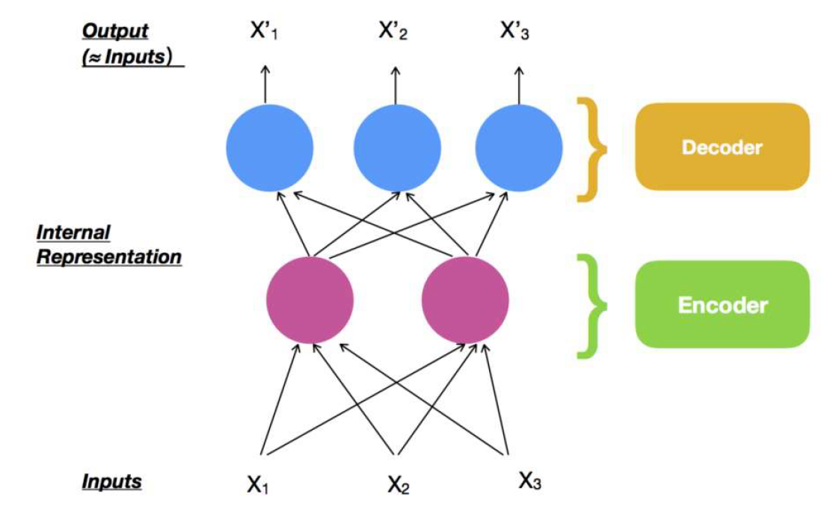
Autoencoder neural network

Slide 21
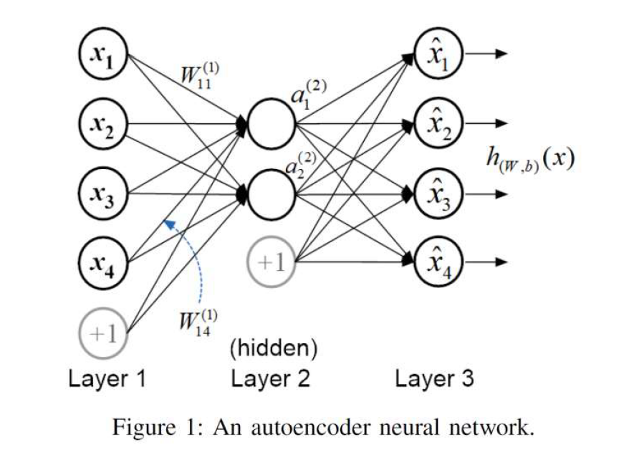
Autoencoder neural network

Slide 22
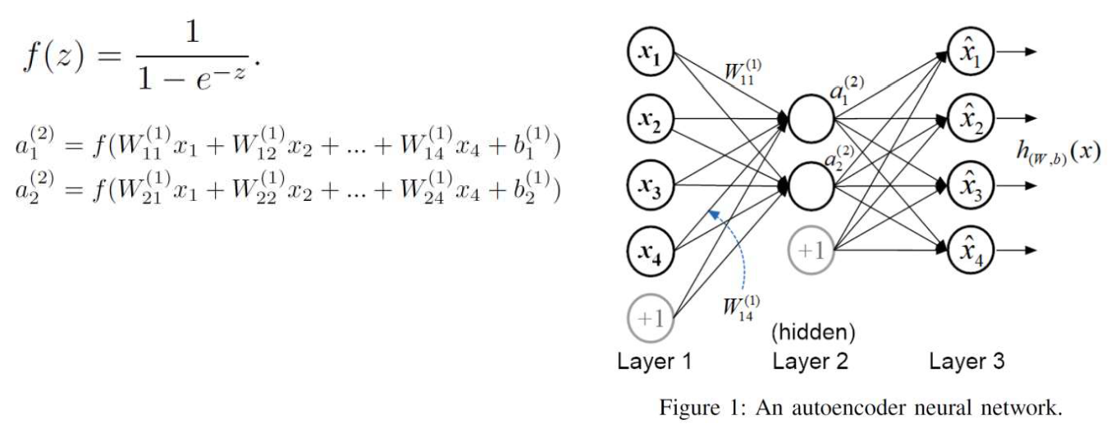
The hyper parameters
Neural Network=input+Weight+Bias+Activation function

Slide 23
Reference
Basics of Autoencoders.pdf
https://www.slideshare.net/AshokGovindarajan/autoencoders-147905176?from_action=save
https://blog.keras.io/building-autoencoders-in-keras.html
T. Luo and S. G. Nagarajan, "Distributed Anomaly Detection Using
Autoencoder Neural Networks in WSN for IoT," 2018 IEEE
International Conference on Communications (ICC), Kansas City, MO,
2018, pp. 1-6.doi: 10.1109/ICC.2018.8422402

